Slide 1
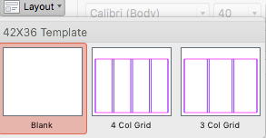
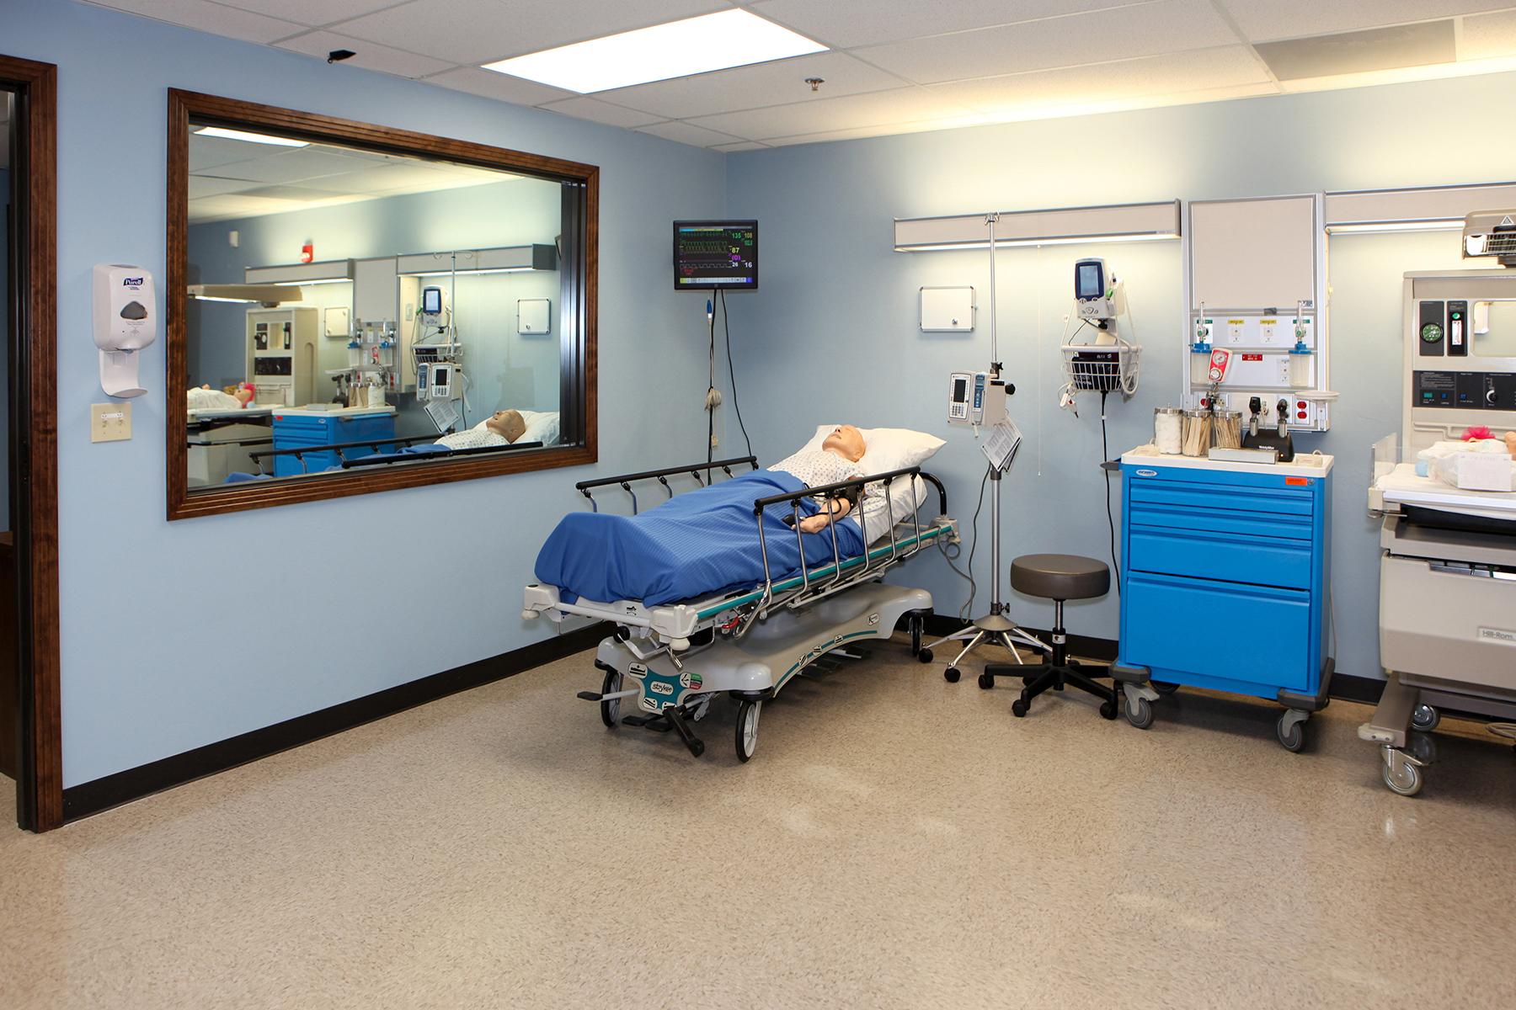
What is a Research Poster?
Posters are widely used in the academic community, and most conferences include poster presentations in their program. Research posters summarize information or research concisely and attractively to help publicize it and generate discussion.
The poster is usually a mixture of brief text mixed with tables, graphs, pictures, and other presentation formats. At a conference, the researcher stands by the poster display while other participants can come and view the presentation and interact with the author.
General Design Principles
Keep the layout so it is readable in columns (top to bottom, then across from left to right).
Try to balance the items you put on the poster – for example, do not have all the diagrams, charts and pictures in just one column. Spread them out as evenly as possible.
Avoid putting images behind text – it makes the text harder to read.
Title is at the top – either top centered or top left aligned.
Title text size is usually 72-125 point depending upon length of title, usually set in bold. Use easy to read text…Calibri, Myriad Pro, Arial, or Helvetica. Stay away from fonts that are hard to read such as scripts. Avoid using all capitals in long titles and in paragraphs.
Section Header text is usually 36-48 point depending upon length of text. Try to be consistent, using the same size for all section headers. Text can be set in bold, in all capitals or sentence style.
Paragraph text is usually 24-40 point depending upon the amount of text but try be consistent throughout your poster.
The eye likes a margin. Putting text and images hard up against the edge of the poster makes it look crowded and it becomes harder to read.
Keep text to a minimum. Too many words and people will not read it – they will lose interest more easily and they often just look at the parts that stand out – such as headlines and figures.
It is important to have a certain amount of ‘white space’ on your poster to help guide the reader through the layout.
Omit complex analyses and formulas as not all viewers will understand it.
Avoid blocks of text longer than 15 lines.
Minimize use of Underlining – use italics instead.
It is important to have consistent line spacing throughout for a poster to look professional and allow for ease of readability.
Avoid Justify Alignment it usually creates large gaps between words.
It is advisable to use some graphics on your poster – pictures, charts, flow diagrams etc. These will help break up blocks of text and make the poster more attractive.
Avoid the use of low resolution images. If unsure of the resolution, zoom to 100%...if the photo looks burry, it’s going to print blurry.
Review – it is important that you prepare the poster in advance and get some other people to review it and provide you with suggestions. They may spot grammatical/typing errors, or point out sentences that are difficult to understand. What you understand, others may not – so it is important to gain other peoples point of view.
It’s rather embarrassing at a poster presentation when you have a typo on your poster. So double check and then check again!
Title is at the top
either top centered or top left aligned
Jane Doe, MSNc, BA; Jane Doe, MSNc, BS Faculty Mentor: Jane Doe, PhD, APRN, CPNP
4 or 3 Col Grid
Use the Layout Tab to allow you to switch between a 3 or 4 column Grid making it easy to arrange and align your content. When finished, just turn it back to blank.
Section Header
Section Header
Section Header
NEC ODIO MATTIS, MOLLIS LACUS ET
Ut cursus velit lectus, in bibendum tortor viverra ut. Praesent auctor, justo sit amet dictum condimentum, est turpis elementum nunc, adipiscing placerat libero sapien sit amet risus. Aliquam felis dolor, varius ut varius vel, pellentesque eu risus.
Vivamus porta nulla a purus elementum placerat. Quisque quis scelerisque enim. Proin aliquam lectus at viverra venenatis. Ut a rutrum purus. Donec hendrerit sapien sit amet urna porta fringilla. Phasellus suscipit sed nibh vel scelerisque. Sed pulvinar nisi ut dui
Vivamus porta nulla a purus elementum placerat. Quisque quis scelerisque enim. Proin aliquam lectus at viverra venenatis. Ut a rutrum purus. Donec hendrerit sapien sit amet urna porta fringilla. Phasellus suscipit sed nibh vel scelerisque. Sed pulvinar nisi ut dui
NEC ODIO MATTIS, MOLLIS LACUS ET
Nec odio mattis, mollis lacus et, venenatis purus. Ut cursus velit lectus, in bibendum tortor viverra ut. Praesent auctor, justo sit amet dictum condimentum, est turpis elementum nunc, adipiscing placerat libero sapien sit amet risus. Aliquam felis dolor, varius ut varius vel, pellentesque eu risus.
Vivamus porta nulla a purus elementum placerat. Quisque quis scelerisque enim. Proin aliquam lectus at viverra venenatis. Ut a rutrum purus. Donec hendrerit sapien sit amet urna porta fringilla. Phasellus suscipit sed nibh vel scelerisque. Sed pulvinar nisi ut dui
Vivamus porta nulla a purus elementum placerat. Quisque quis scelerisque enim. Proin aliquam lectus at viverra venenatis. Ut a rutrum purus. Donec hendrerit sapien sit amet urna porta
Section Header
Section Header
Section Header
Avoid putting images behind text – it makes the text harder to read.
Title is at the top – either top centered or top left aligned.
The eye likes a margin. Putting text and images hard up against the edge of the poster makes it look crowded and it becomes harder to read.
Keep text to a minimum. Too many words and people will not read it – they will lose interest more easily and they often just look at the parts that stand out – such as headlines and figures.
It is important to have a certain amount of ‘white space’ on your poster to help guide the reader through the layout.
Omit complex analyses and formulas as not all viewers will understand it.
Avoid blocks of text longer than 15 lines.
Minimize use of Underlining – use italics instead.
It is important to have consistent line spacing throughout for a poster to look professional and allow for ease of readability.
It is advisable to use some graphics on your poster – pictures, charts, flow diagrams etc. These will help break up blocks of text and make the poster more attractive.
Avoid the use of low resolution images.
Review – it is important that you prepare the poster in advance and get some other people to review it and provide you with suggestions. They may spot grammatical/typing errors, or point out sentences that are difficult to understand. What you understand, others may not – so it is important to gain other peoples point of view.
It’s rather embarrassing at a poster presentation when you have a typo on our poster. So double check and then check again!
NEC ODIO MATTIS,
mollis lacus et, venenatis purus. Ut cursus velit lectus, in bibendum tortor viverra ut. Praesent auctor, justo sit amet dictum condimentum, est turpis elementum nunc, adipiscing placerat libero sapien sit amet risus. Aliquam felis dolor, varius ut varius vel,
Section Header
Section Header
Nec odio mattis, mollis lacus et, venenatis purus. Ut cursus velit lectus, in bibendum tortor viverra ut. Praesent auctor, justo sit amet dictum condimentum, est turpis elementum nunc, adipiscing placerat libero sapien sit amet risus. Aliquam felis dolor, varius ut varius vel,
Available on handout

Slide 2
Title is at the top
either top centered or top left aligned
Jane Doe, MSNc, BA; Jane Doe, MSNc, BS Faculty Mentor: Jane Doe, PhD, APRN, CPNP
Section Header
Section Header
Section Header
Section Header
Nec odio mattis, mollis lacus et, venenatis purus. Ut cursus velit lectus, in bibendum tortor viverra ut. Praesent auctor, justo sit amet dictum condimentum, est turpis elementum nunc, adipiscing placerat libero sapien sit amet risus. Aliquam felis dolor, varius ut varius vel, pellentesque eu risus.
Vivamus porta nulla a purus elementum placerat. Quisque quis scelerisque enim. Proin aliquam lectus at viverra venenatis. Ut a rutrum purus. Donec hendrerit sapien sit amet urna porta fringilla. Phasellus suscipit sed nibh vel scelerisque. Sed pulvinar nisi ut dui
Nec odio mattis, mollis lacus et, venenatis purus. Ut cursus velit lectus, in bibendum tortor viverra ut. Praesent auctor, justo sit amet dictum condimentum, est turpis elementum nunc, adipiscing placerat libero sapien sit amet risus. Aliquam felis dolor, varius ut varius vel, pellentesque eu risus.
Vivamus porta nulla a purus elementum placerat. Quisque quis scelerisque enim. Proin aliquam lectus at viverra venenatis. Ut a rutrum purus. Donec hendrerit sapien sit amet urna porta fringilla. Phasellus suscipit sed nibh vel scelerisque. Sed pulvinar nisi ut dui
Nec odio mattis, mollis lacus et, venenatis purus. Ut cursus velit lectus, in bibendum tortor viverra ut. Praesent auctor, justo sit amet dictum condimentum, est turpis elementum nunc, adipiscing placerat libero sapien sit amet risus. Aliquam felis dolor, varius ut varius vel, pellentesque eu risus.
Vivamus porta nulla a purus elementum placerat. Quisque quis scelerisque enim. Proin aliquam lectus at viverra venenatis. Ut a rutrum purus. Donec hendrerit sapien sit amet urna porta fringilla. Phasellus suscipit sed nibh vel scelerisque. Sed pulvinar nisi ut dui
Section Header
Section Header
Section Header
Avoid putting images behind text – it makes the text harder to read.
Title is at the top – either top centered or top left aligned.
The eye likes a margin. Putting text and images hard up against the edge of the poster makes it look crowded and it becomes harder to read.
Keep text to a minimum. Too many words and people will not read it – they will lose interest more easily and they often just look at the parts that stand out – such as headlines and figures.
It is important to have a certain amount of ‘white space’ on your poster to help guide the reader through the layout.
Omit complex analyses and formulas as not all viewers will understand it.
Avoid blocks of text longer than 15 lines.
Minimize use of Underlining – use italics instead.
It is important to have consistent line spacing throughout for a poster to look professional and allow for ease of readability.
It is advisable to use some graphics on your poster – pictures, charts, flow diagrams etc. These will help break up blocks of text and make the poster more attractive.
Avoid the use of low resolution images.
Review – it is important that you prepare the poster in advance and get some other people to review it and provide you with suggestions. They may spot grammatical/typing errors, or point out sentences that are difficult to understand. What you understand, others may not – so it is important to gain other peoples point of view.
It’s rather embarrassing at a poster presentation when you have a typo on your poster. So double check and then check again!
Smart Art
Charts
Tables
Smart Art
Nec odio mattis, mollis lacus et, venenatis purus. Ut cursus velit lectus, in bibendum tortor viverra ut. Praesent auctor, justo sit amet dictum condimentum, est turpis elementum nunc, adipiscing placerat libero sapien sit amet risus. Aliquam felis dolor, varius ut varius vel,
Section Header
Section Header
Since PICOs are framed as research questions, I would delete
Available on handout

Slide 3
Title is at the top
either top centered or top left aligned
Jane Doe, MSNc, BA; Jane Doe, MSNc, BS Faculty Mentor: Jane Doe, PhD, APRN, CPNP
Section Header
Section Header
Section Header
Section Header
Nec odio mattis, mollis lacus et, venenatis purus. Ut cursus velit lectus, in bibendum tortor viverra ut. Praesent auctor, justo sit amet dictum condimentum, est turpis elementum nunc, adipiscing placerat libero sapien sit amet risus. Aliquam felis dolor, varius ut varius vel, pellentesque eu risus.
Vivamus porta nulla a purus elementum placerat. Quisque quis scelerisque enim. Proin aliquam lectus at viverra venenatis. Ut a rutrum purus. Donec hendrerit sapien sit amet urna porta fringilla. Phasellus suscipit sed nibh vel scelerisque. Sed pulvinar nisi ut dui
Nec odio mattis, mollis lacus et, venenatis purus. Ut cursus velit lectus, in bibendum tortor viverra ut. Praesent auctor, justo sit amet dictum condimentum, est turpis elementum nunc, adipiscing placerat libero sapien sit amet risus. Aliquam felis dolor, varius ut varius vel, pellentesque eu risus.
Vivamus porta nulla a purus elementum placerat. Quisque quis scelerisque enim. Proin aliquam lectus at viverra venenatis. Ut a rutrum purus. Donec hendrerit sapien sit amet urna porta fringilla. Phasellus suscipit sed nibh vel scelerisque. Sed pulvinar nisi ut dui
Nec odio mattis, mollis lacus et, venenatis purus. Ut cursus velit lectus, in bibendum tortor viverra ut. Praesent auctor, justo sit amet dictum condimentum, est turpis elementum nunc, adipiscing placerat libero sapien sit amet risus. Aliquam felis dolor, varius ut varius vel, pellentesque eu risus.
Vivamus porta nulla a purus elementum placerat. Quisque quis scelerisque enim. Proin aliquam lectus at viverra venenatis. Ut a rutrum purus. Donec hendrerit sapien sit amet urna porta fringilla. Phasellus suscipit sed nibh vel scelerisque. Sed pulvinar nisi ut dui
Section Header
Section Header
Section Header
Avoid putting images behind text – it makes the text harder to read.
Title is at the top – either top centered or top left aligned.
The eye likes a margin. Putting text and images hard up against the edge of the poster makes it look crowded and it becomes harder to read.
Keep text to a minimum. Too many words and people will not read it – they will lose interest more easily and they often just look at the parts that stand out – such as headlines and figures.
It is important to have a certain amount of ‘white space’ on your poster to help guide the reader through the layout.
Omit complex analyses and formulas as not all viewers will understand it.
Avoid blocks of text longer than 15 lines.
Minimize use of Underlining – use italics instead.
It is important to have consistent line spacing throughout for a poster to look professional and allow for ease of readability.
It is advisable to use some graphics on your poster – pictures, charts, flow diagrams etc. These will help break up blocks of text and make the poster more attractive.
Avoid the use of low resolution images.
Review – it is important that you prepare the poster in advance and get some other people to review it and provide you with suggestions. They may spot grammatical/typing errors, or point out sentences that are difficult to understand. What you understand, others may not – so it is important to gain other peoples point of view.
It’s rather embarrassing at a poster presentation when you have a typo on your poster. So double check and then check again!
Smart Art
Charts
Tables
Smart Art
Nec odio mattis, mollis lacus et, venenatis purus. Ut cursus velit lectus, in bibendum tortor viverra ut. Praesent auctor, justo sit amet dictum condimentum, est turpis elementum nunc, adipiscing placerat libero sapien sit amet risus. Aliquam felis dolor, varius ut varius vel,
Section Header
Section Header
Since PICOs are framed as research questions, I would delete
Available on handout

