Slide 1
University of San Diego School of Law 2015 Climate and Energy Law Symposium
Clean Power Plan Federalism
Amy L. Stein
Associate Professor of Law
University of Florida
Levin College of Law

Slide 2
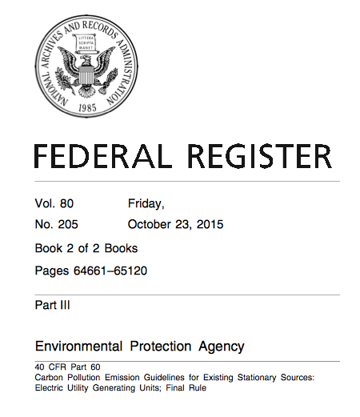
Roadmap
Clean Power Plan Primer
Cooperative Federalism?
Uncooperative Federalism?

Slide 3
Clean Power Plan Primer

Slide 4
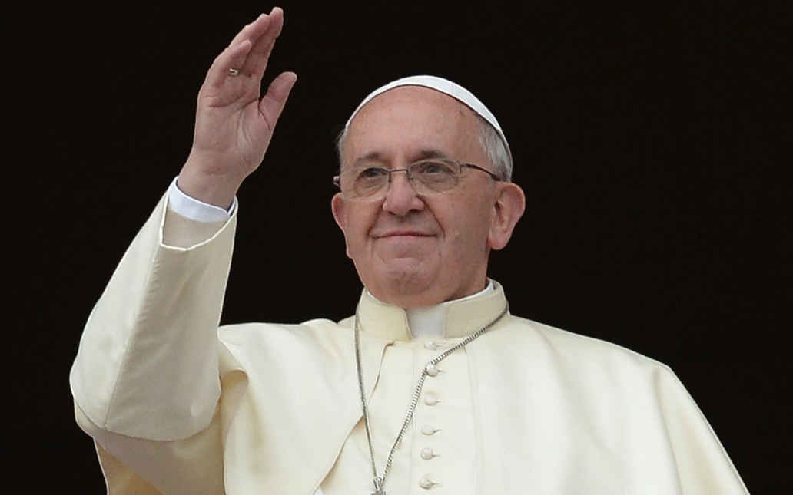
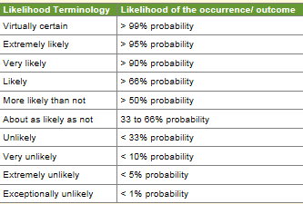
Why GHG?
“what is no longer seriously disputed is that humans are the main agents of climate change.”
Source: https://www.ipcc.ch/pdf/assessment-report/ar5/syr/AR5_SYR_FINAL_SPM.pdf (2014)
Notes:
How can we have a discussion of the CPP without first addressing climate change. That is the entire reason we have the CPP
Source: http://www.economist.com/blogs/economist-explains/2014/11/economist-explains

Slide 5
Why Power Plants?
Source: http://epa.gov/airquality/cpp/cpp-presentation.pdf.

Slide 6
Why the Clean Air Act?
Lack of Congressional action
Greenhouse gases (GHG), including CO2, are pollutants that EPA can regulate under the Clean Air Act (Mass v EPA)
EPA GHG Endangerment Finding
EPA GHG Rules: mobile sources
EPA GHG rules: new stationary sources
EPA GHG rules: existing stationary sources
Notes:
’s finding that GHG concentrations in the atmosphere endanger public health

Slide 7
CPP Basics
Goal: 32% reduction in CO2 from baseline levels (2005) by 2030
Application: certain existing fossil-fuel power plants
Steam generating units (usually coal)
Stationary combustion turbines (usually oil or natural gas)
Phased-in (smooth) glide path
Step 1 –2022-2024
Step 2 –2025-2027
Step 3 –2028-2029

Slide 8
Cooperative Federalism

Slide 9
Cooperative Federalism
Federal standards that states can implement
Clean Air Act – State Implementation Plan and Title V
Clean Water Act – Water Quality Standards and NPDES
Surface Mining Control Reclamation Act
Public Utility Regulatory Policies Act (1978)
Telecommunications Act of (1996)
Inherent tensions that are imperative to the proper functioning of the system
Notes:
And specifically, the type of coop federalsim that is referred to as “conditional preemption”
The typical federalism factors – some from both can be achieved.

Slide 10
Clean Air Act Primer – 111(d)
Congress directs the EPA to issue regulations that require states to submit state implementation plans (SIPs) which
(A) “establish standards of performance for any existing source for any air pollutant”
(B) “provides for the implementation and enforcement of such standards of performance.” CAA Section 111(d)
Standard of performance means an emission limit that reflects “the degree of emission limitation achievable through the application of the best system of emission reduction which (taking into account the cost of achieving such reduction and any non air quality health and environmental impacts and energy requirements)” the EPA determines has been adequately demonstrated. CAA Section 111(a).

Slide 11
Clean Air Act Primer – 111(d)
Congress directs the EPA to issue regulations that require states to submit state implementation plans (SIPs) which
(A) “establish standards of performance for any existing source for any air pollutant”
(B) “provides for the implementation and enforcement of such standards of performance.” CAA Section 111(d)
Standard of performance means an emission limit that reflects “the degree of emission limitation achievable through the application of the best system of emission reduction which (taking into account the cost of achieving such reduction and any non air quality health and environmental impacts and energy requirements)” the EPA determines has been adequately demonstrated. CAA Section 111(a).

Slide 12
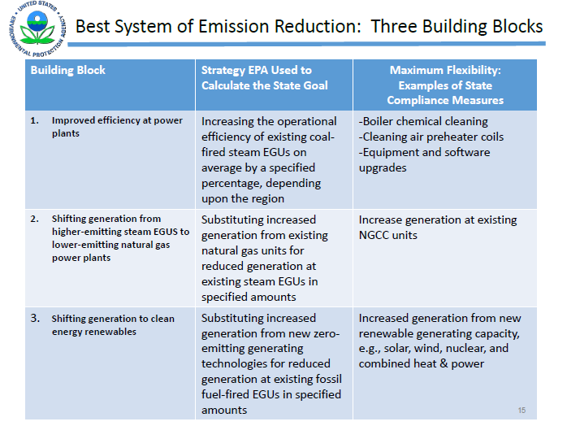
What is the best system of emission reduction (BSER) for reducing CO2 from power plants?
Source: http://epa.gov/airquality/cpp/cpp-presentation.pdf.

Slide 13
CPP Basics
EPA calculated performance rates
EPA translated those performance rates into a state goal –measured in mass and rate –based on each state’s unique mix of power plants in 2012
States must submit plans for meeting these goals by 2016 or request an extension
http://cleanpowerplanmaps.epa.gov/cpp/
Notes:
Mass = total tons emitted annually
Rate = tons by MHhr
In other words, EPA set goals, timeline, and requirements of SIPs, states do rest

Slide 14
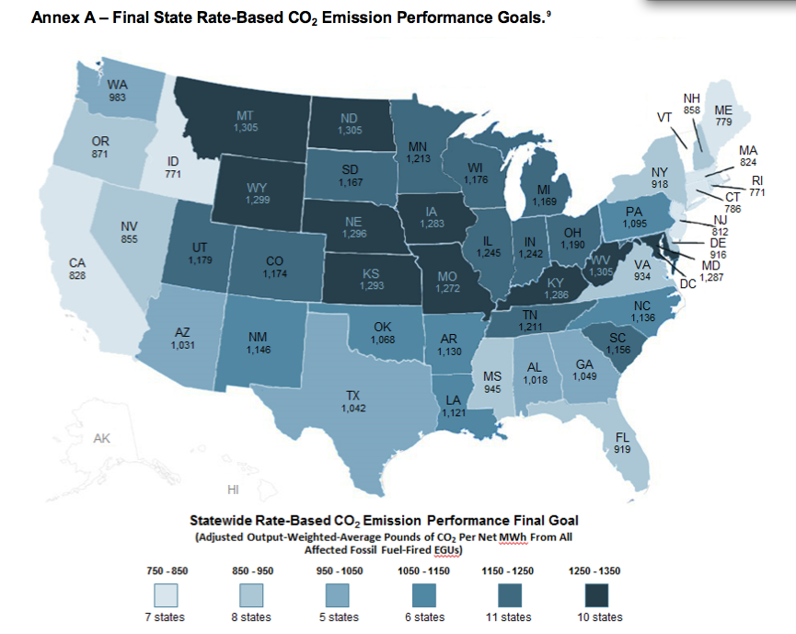
Source: Latham & Watkins, EPA Finalizes Historic Greenhouse Gas Reduction Program

Slide 15
Source: http://epa.gov/airquality/cpp/cpp-presentation.pdf.

Slide 16
Elements of CPP SIP Extension Request
Describe Approaches
Single or Multi-state Plan
Rates or Mass
Emission standards or state measures
State’s Progress
Explain need for extension
Time to work with other states
Time for new state regulatory or legislative action
Describe opportunities for public comment

Slide 17
Notes:
States are not limited to the building blocks for compliance. That was only for developing the BSER

Slide 18
Source: EPA, http://www2.epa.gov/cleanpowerplantoolbox/state-plan-decision-tree

Slide 19
Uncooperative Federalism

Slide 20
A Few Key Federalism Questions
What powers did Congress give the federal and state actors within these programs?
How are the federal and state actors supposed to navigate the boundaries of these powers?
What happens when federal and state actors disagree?
Notes:
What powers did Congress give the feds and the states within these programs?
Did EPA exceed its statutory authority by relying on BSER outside the fence lines?
Is EPA encroaching on state jurisdiction over electricity?
Is EPA encroaching on FERC jurisdiction over electricity?
How are the feds and states suppose to navigate the boundaries of these powers?
Is EPA “coercing” the states?
What happens when federal and state actors disagree?
Should EPA get deference?
Legislative “Glitch”
Choice of BSER
Cooperative federalism programs, where federal actors develop national standards and state actors take primacy in their implementation and enforcement, are not normally the battleground for augmenting states’ rights. Instead, states are viewed as the “servant” in this master-servant relationship dictated by Congress. Recent theories of uncooperative federalism are changing that. Professors Heather Gerken and Jessica Bulman-Pozen have articulated a compelling alternative theory of state empowerment, one that urges a closer examination of the power that states wield as “servants” within cooperative federalism programs. They suggest that states’ subservient position in this program actually provides them with unique opportunities to dissent from within, using their position as insiders to counter national policies in a manner that they refer to as “uncooperative federalism.”
See, e.g., Wyoming v. United States, 279 F.3d 1214, 1231-33 (10th Cir. 2002) (noting that the states “serve merely as agents for the implementation of federal water pollution control policy; it is the federal government, not the individual states, that shapes and directs the regulatory policy”).
Jessica Bulman-Pozen, Heather K. Gerken, Uncooperative Federalism, 118 Yale L.J. 1256, 1310 (2009).
States
Is the analysis different because states have already agreed to participate in this program?
Are the anti-commandeering concerns less because they are within a cooperative federalism structure?
Federal
Should they defer more?

Slide 21
A Few Forms of State Dissent
Register its disagreement
Failure/Refusal to Act
Defensive Maneuvers
Lawsuits
Notes:
Caution that they are repeat players with the gov

Slide 22
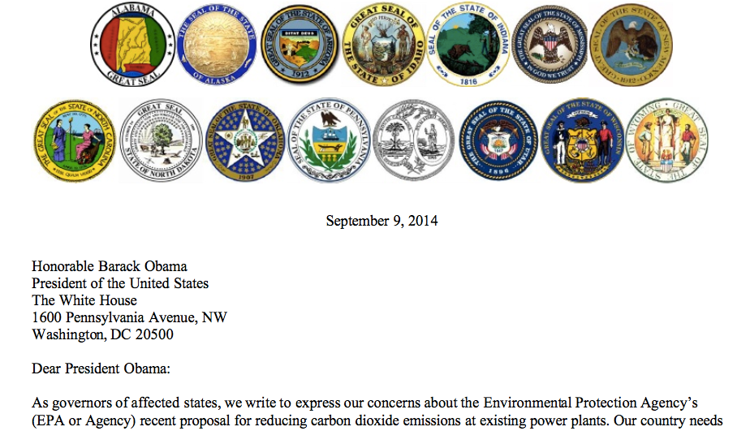
Register its Disagreement

Slide 23
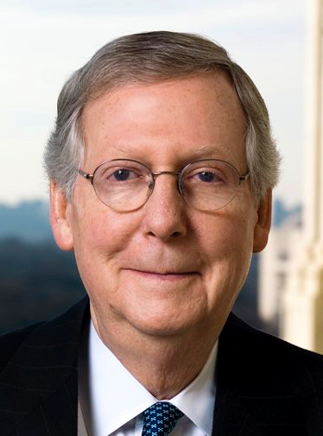
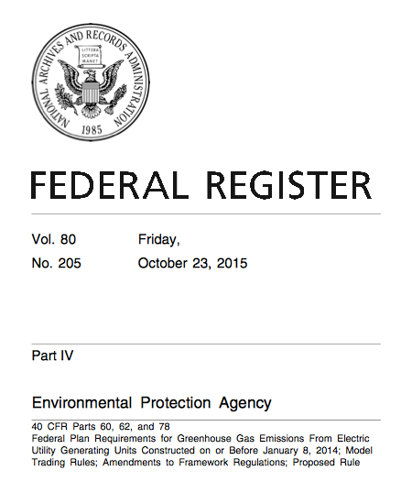
Failure/Refusal to Act

Slide 24
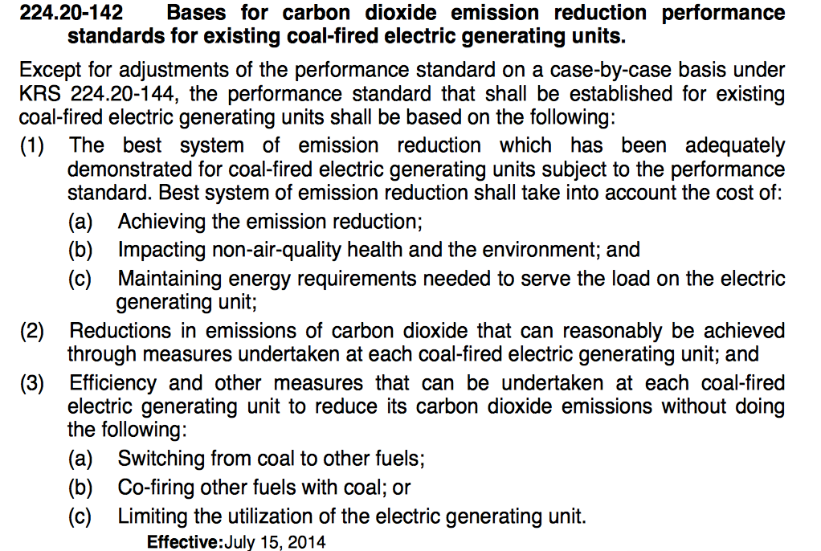
Defense: Kentucky
Notes:
Exhibit A

Slide 25
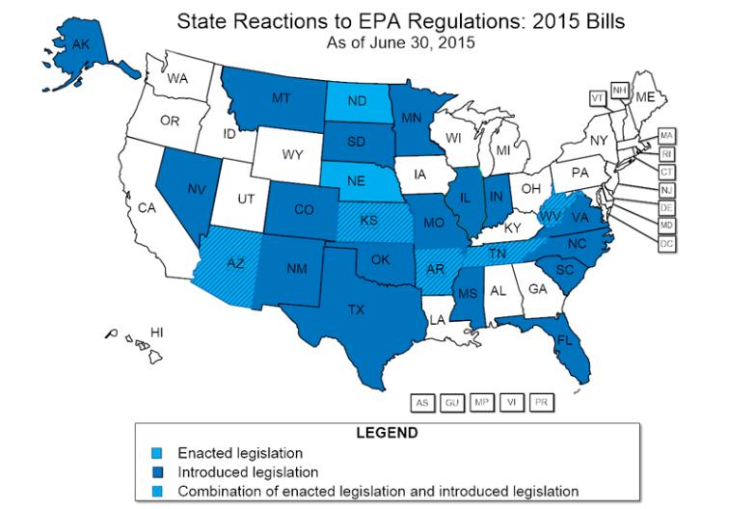
Defense: State Legislatures
Source: National Conference of State Legislatures, http://www.ncsl.org/research/energy/states-reactions-to-proposed-epa-greenhouse-gas-emissions-standards635333237.aspx

Slide 26
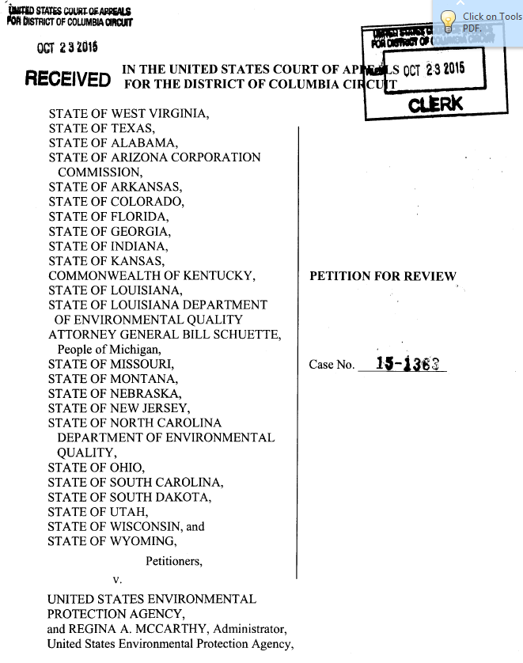
Notes:
West Virginia v EPA

Slide 27
CPP as Empowering States? (aka The New Nationalists – Gerken)
Strength in Compliance?
Flexibility
Implementation
Enhanced Relationships
Intrastate
Interstate
Strength in Defiance?
Block Resistance
Force EPA’s Hand
Force Legislative Hand
Notes:
ASSUMING EPA IS WITHIN ITS AUTHORITY
COMPLIANCE
Flexibility within
Implementation – real power lies in money and manpower
Enhanced Relationships –
Forging relationships between PUCs and state environmental agencies
New
Strength in numbers – if all 26 states refuse, will EPA have the capacity to implement FIPs in all those places?
Is the lack of FIP flexibiltiy worth it?
Cooperative federalism programs, where federal actors develop national standards and state actors take primacy in their implementation and enforcement, are not normally the battleground for augmenting states’ rights. Instead, states are viewed as the “servant” in this master-servant relationship dictated by Congress. Recent theories of uncooperative federalism are changing that. Professors Heather Gerken and Jessica Bulman-Pozen have articulated a compelling alternative theory of state empowerment, one that urges a closer examination of the power that states wield as “servants” within cooperative federalism programs. They suggest that states’ subservient position in this program actually provides them with unique opportunities to dissent from within, using their position as insiders to counter national policies in a manner that they refer to as “uncooperative federalism.”
See, e.g., Wyoming v. United States, 279 F.3d 1214, 1231-33 (10th Cir. 2002) (noting that the states “serve merely as agents for the implementation of federal water pollution control policy; it is the federal government, not the individual states, that shapes and directs the regulatory policy”).
Jessica Bulman-Pozen, Heather K. Gerken, Uncooperative Federalism, 118 Yale L.J. 1256, 1310 (2009).
States
Is the analysis different because states have already agreed to participate in this program?
Are the anti-commandeering concerns less because they are within a cooperative federalism structure?
Federal
Should they defer more?
“States” are not one state
State and federal actions cannot be evaluated in a vacuum
The value of state dissent cannot be evaluated without considering the federal response to such dissent
Evaluating the appropriateness of the federal response is dependent on multiple variables

Slide 28
Thank you
Thoughts or questions?
Amy L. Stein
Associate Professor, UF Levin College of Law
stein@law.ufl.edu
Scholarship: http://ssrn.com/author=1216973

